Slide 1

Arcaninjadroid: Kitty Catastrophe
By Rémy Lapointe
Pitch date: June 3rd 2018

Slide 2

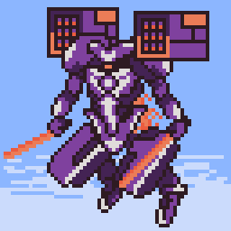
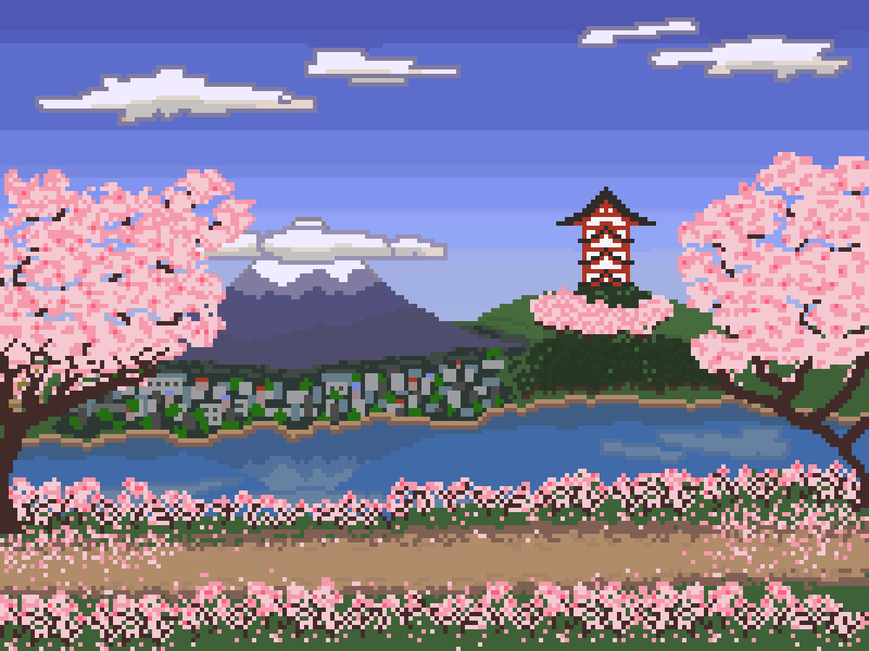
Who am I?
Led Spell Spiel during Summer 2017
Helped out on various club projects since, and other personal endeavours
Physics and CS by day, resident pixel artist by night

Slide 3

The basics
Javascript/HTML5 on Canvas
Pixelated style
4 months (until September 30th)

Slide 4
The story
Aliens have arrived on Earth
They’ve agreed to leave forever, in exchange for most of Earth’s kittens
Refusing to surrender your friend, you spent 8 years mastering ninja techniques, learning the magical arts, and augmenting yourself with robotic parts. The first Arcaninjadroid. Now, you must rescue Kitten!!!

Slide 5
The gameplay
You must use your three fighting styles : Arcane, Ninja and Android.
Android is for ground combat, punches and kicks. With enough hits, you can stun opponents.
Launch stunned enemies in the air and become Ninja. You slice and dice swiftly in the air and rack up combos.
When the combo is over, you switch to Arcane. You can fly and shoot spells like mad, while the power depends on your previous ninja combo.
TLDR: Android on ground, Ninja in air, Arcane as finisher.

Slide 6
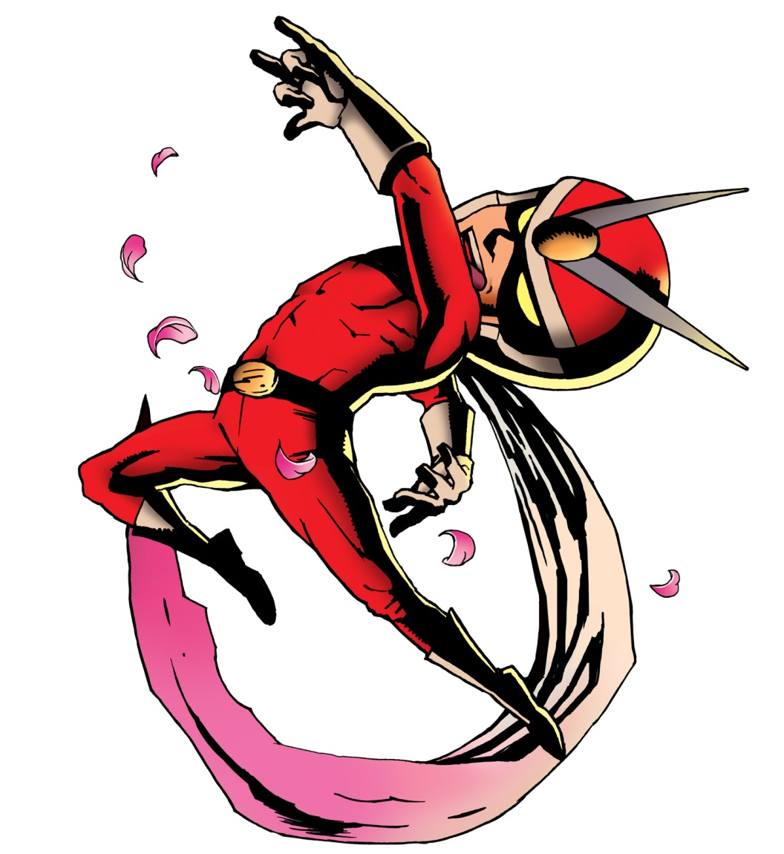
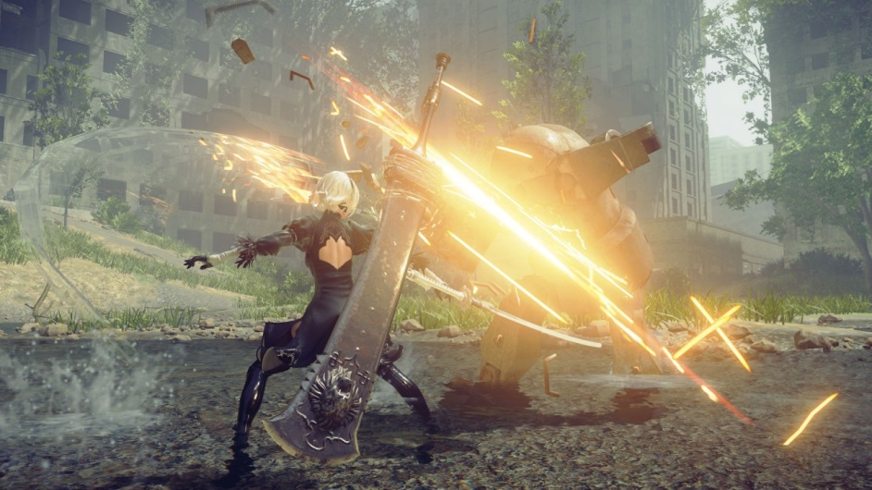
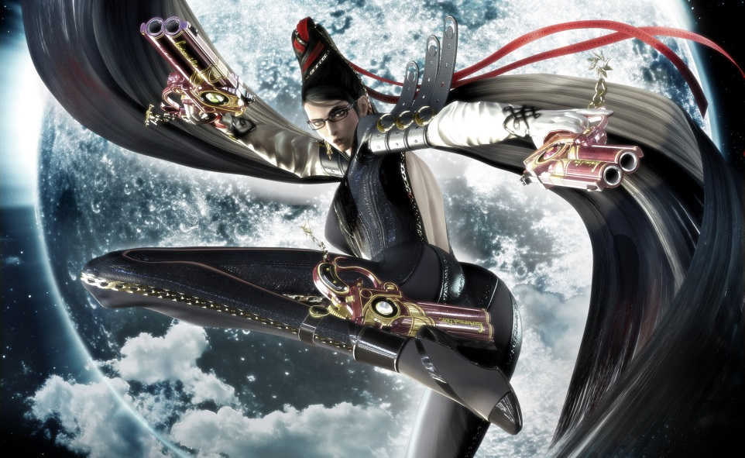
The inspiration
Early to current day Platinum Games
Focus on action and fluid, stylish combat

Slide 7
Demo time!!!

Slide 8

The main challenges
Animating humanoïds. I will go full Disney boi
Fluid, satisfying gameplay. Will need help with gameplay design and balancing.
I’ll also need help with:
Environment/level design
Minimalistic UI: combo counter and HP bar etc.
Enemy design, art, implementation etc.
Animation: difficulty will vary a lot!
SFX: many kicks will be received in the face!
Action music!!! :D
If you’re up for it: help me with the gameplay/engine code. There is much advanced coding (state machines, animation, collision detection and more) we can figure out together! :D

Slide 9
Schedule / Milestones
Week of June 3rd: Pitch, gameplay coding, main character design.
Until late June: code framework and Android gameplay, level design
Late June until end of July: Remy goes Disney, Ninja gameplay.
Early August: Asset creation and level building.
Mid to end of August: Arcane gameplay
September: Level creation, asset creation, balancing and polish, and release on the 30th! :D

Slide 10
Other comments
This project is pretty ambitious. Please don’t be intimidated at making small pieces and handing me the rest.
For example: making an enemy can be just a single sprite, not sprite + anims + colliders + code ;)
Same goes for coding: please don’t look at the code and go « OMG there’s already a million things going on, forget it » If you wanna code, write on Slack and we’ll find you something to code :) You can expect a quick response
The concept is wacky, but believe me: I know where I’m going, and I assure you the end result will be worth your efforts
This will be fun! :) I’m excited to work with all of you!

Slide 11

Questions? :)

